Slide 1

2 out of 10
Notes:
The average level of automation for test activities is around 16%

Slide 2

America was already discovered, why we would like to explore it all over again?
Notes:
Let accept what was already created and enhance it into new unknown so exciting and marvelous direction.
Shall we ?
P.S. Christopher till the end of his life believed he has reached Asia

Slide 3

Nearshore Test Center Allure End to End test framework
Łukasz Stefaniszyn
February 2018

Slide 4




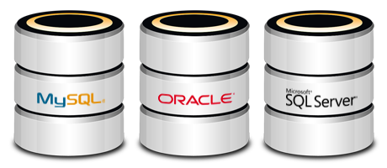
E2E Test Framework for DevOps & Smart Automation
UI
API
Unit
Task Description
Embrace Test Automation in project with minimal cost and time
Bring up to speed testers and developers with common quality goal
Plug in/out framework features to fit project needs
One test case to validate 3 tiers of app (Database, WebService, UI)
Accelerate tests execution (parallel execution, env auto-scaling)
Standardize test develop process
DevOps
Service provided by Capgemini
Takeover of operation and therefore delivery of the entire service in accordance with DevOps procedural model.
Capgemini is partnering with client on implementation of IT Projects Delivery Transformation
Tool agnostic approach / Innovative architecture – Test Framework with examples
Test execution infrastructure (Jenkins as code pipeline, Docker images)
Scalable and resilient UI web browser environment (Selenium Grid)
E2E test in one file
Core functions (Java, Cucumber)
UI module (Selenium)
WebService module (REST, SOAP)
DataBase module (Oracle, Cassandra)
Benefit for the Customer
Resilient and robust building and validation process
Shift quality gates closer to software developer process
Team quality awareness increase - include Unit Tests, Static Analyze, Security Tests, Performance
Transparent test execution environment to any infrastructure. Touch base with Cloud solution
Faster Quality and DevOps driven delivery
Proven frameworks, technologies and processes

Slide 5

Where we all are
Process defragmentation
Team silos
Validation at the last deliverable stage
Tools oriented approach

Slide 6
E2E Test Framework modules
UI
API
BACKEND
Database module
WebAPI module
UI (Selenium) module
Selenium Grid
Mobile (Appium) app *
Mobile Grid *
Standalone APP *
Security module
DevOps module
Test core module
* - task not started, to be defined

Slide 7
Benefits to project
End to end project verification under one solution
Shift left quality gates
Easy to enhance
Resilient and robust DevOps driven delivery
Team quality awareness

Slide 8
E2E Test Framework modules
Core functions
UI test module
WebAPI test module
Database test module
Mobile App test module *
Mobile Grid infrastructure *
Security test module
Selenium Grid infrastructure
DevOps infrastructure
Standalone app test module *
*) - task not started, to be planned

Slide 9
Mr Checker E2E Framework road map
Application infra
WebAPI module
Database test module
Service virtualization module
Queue module
Security module
2019
Apr
May
Jun
Jul
Aug
Sep
Oct
Nov
Dec
2020
Application test infrastructure
Service Virtualization test modules
Security test modules
Database (SQL) test modules
Queue (MQ) test modules
WebAPI (REST) test modules
Mobile App (Appium Android) test modules
TBD
Mobile Grid (Emulators Android)
TBD
Standalone app (SWING) test modules
TBD

Slide 10

Key takeaways
Switch ON quality
One solution to fit all
Break team silos

Slide 11
Mr Checker E2E test framework modules

Slide 12
Mr Checker E2E Test Framework modules Overview status
DONE
Core test functions
UI test module
WebAPI test module
Security test module
Database test module
Standalone app test module *
Mobile App test module *
Framework backend
Selenium Grid infrastructure
DevOps infrastructure
Mobile Grid infrastructure *
DONE
DONE
ONGOING
Q2 2018
ONGOING
Q2 2018
DONE
ONGOING
Q3 2018
*) - planned

Slide 13
E2E Test Framework modules Test Core module
Test core module
UI
API
BACKEND
Database module
WebAPI module
UI (Selenium) module
Selenium Grid
Mobile (Appium) app *
Mobile Grid *
Standalone APP *
Security module
DevOps module
Test core module

Slide 14



Core functionality ingredients
Test report with logs and/or screenshots
Test groups/tags
Data Driven (inside test case, external file)
Test case parallel execution
Run on independent OperatingSystem
Externalize test environment (DEV, QA, PROD)
BDD - Gherkin – Cucumber approach

Slide 15
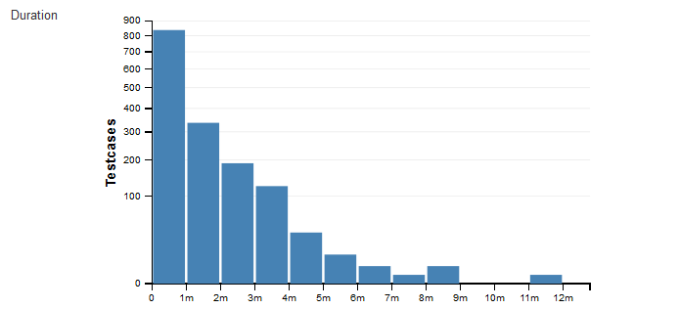
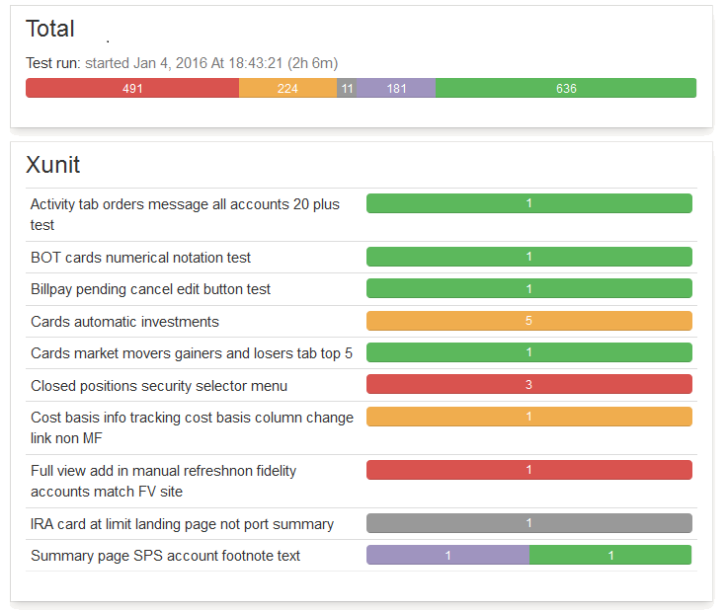
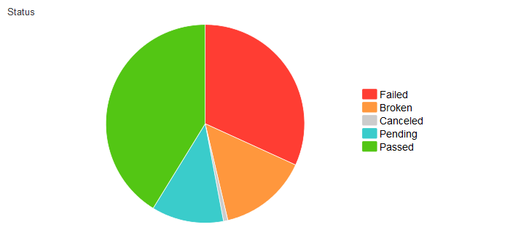
Test Case – report
Daily test status control
Generating reports from executed test cases
Split tests status into: Passed / Failed / Ignore / Broken

Slide 16
Test Case – report
Create report as local file
Command line
> mvn test allure:report -Dtest=TS_Tag1
Report folder (open by firefox browser):
.\target\site\allure-maven-plugin\index.html
Create report with http server
Command line
> mvn test allure:serve -Dtest=TS_Tag1
Report url:
http://127.0.0.1:8080

Slide 17
Test Case – categorize functionality and severity
Regression Suite
Smoke
Business vital functionalities
Functional Suite
Smoke
Business function A
Single Resposibilty Unit
Single Page
Business function B
Specific test case
Full scope of test cases

Slide 18
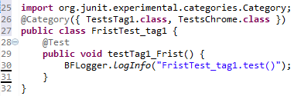
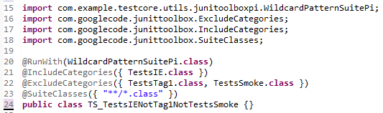
Test Case – categorize functionality and severity
Adnotation in Test Case @Category
Adnotation in Test Suite @IncludeCategories, @ExcludeCategories
Eclipse
OR
Command line
> mvn test surefire:test site -Dtest=TS_TestsIENotTag1NotTestsSmoke
Example test case (Ctrl + Shift + R): FristTest_tag1, TS_TestsIENotTag1NotTestsSmoke

Slide 19
Test Case - data driven approach
Test Data
Test business logic
Test Case
Internal data feed
External data feed
As a $user I should ….
Result validation
File
Data Base
API
Data table

Slide 20
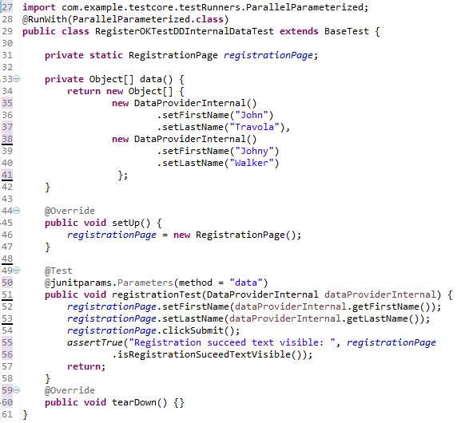
Test Case - data driven approach - Internal Data Driven
Internal Data Driven – data as part of test case
Example test case (Ctrl + Shift + R): RegisterOKTestDDInternalDataTest

Slide 21
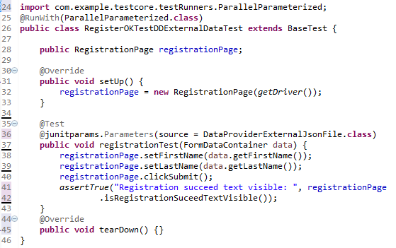
Test Case - data driven approach - External Data Driven
External Data Driven – data as external file injected in test case
Example test case (Ctrl + Shift + R): RegisterOKTestDDExternalDataTest

Slide 22
Test Case - system under test environments
Test Case
QA
PROD
DEV
SIT

Slide 23
Test Case - system under test environments
service variable | DEV | QA | PROD
WWW_FONT_URL | http://demoqa.dev.com/ | http://demoqa.qa.com/ | http://demoqa.com/
Eclipse
OR
Command line
> mvn test surefire:test site -Dtest=RegistryPageTest -Denv=DEV
Environment table is saved here: \src\test\resources\enviroments\environments.csv

Slide 24
E2E Test Framework modules UI test module
UI (Selenium) module
UI
API
BACKEND
Database module
WebAPI module
UI (Selenium) module
Selenium Grid
Mobile (Appium) app *
Mobile Grid *
Standalone APP *
Security module
DevOps module
Test core module

Slide 25
UI Selenium test module ingredients
Malleable resolution
Remote Web Design
Mobile browsers
Support for many browsers
Internet Explorer, Edge
Chrome, Firefox
Safari
User friendly actions
elementCheckBox
elementDropdown, etc.
Ubiquise test execution
locally
against Selenium Grid through Jenkins
Page Object Model architecture
Selenium WebDriver with Java
Map page actions
Seprate business actions
Web driver auto downloder

Slide 26
User Interface Test Case ingredients
Test Case
Resolution
Browsers
Test Environment
Data Driven
Smart data discover
One Test Case fits all ingredients
1 TC equals 144 TCs
30 min equals 72 hours

Slide 27
One Test Case fits all browsers
Firefox
Chrome
IE
Edge
Safari
Test Case

Slide 28
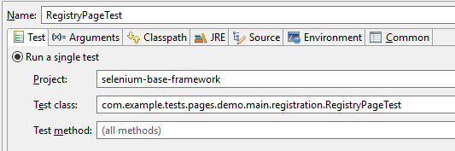
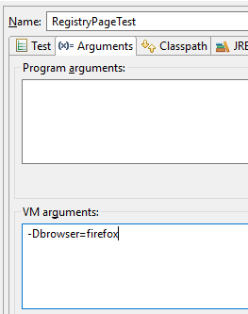
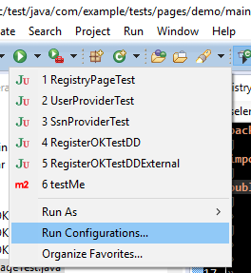
One Test Case fits all browsers – Firefox, Chrome, IE, Edge, Safari, PhantomJS
2
1
Eclipse
OR
Command Line
3
> mvn test surefire:test site -Dtest=RegistryPageTest -Dbrowser=firefox

Slide 29
One Test Case for Responsive Web Design and Mobile
Test Case
Android
iOS
Classic web
Mobile
Responsive Web Design

Slide 30
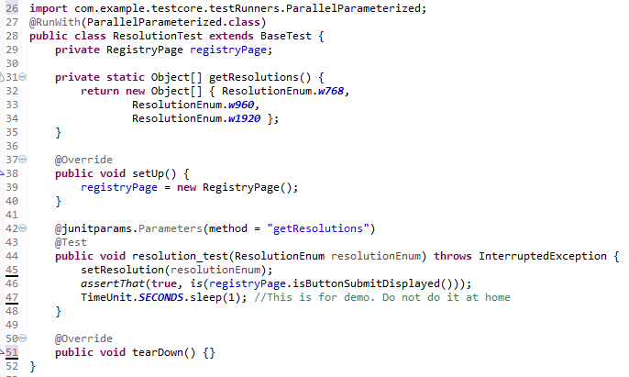
One Test Case for Responsive Web Design and Mobile
Example test case (Ctrl + Shift + R): ResolutionTest

Slide 31
E2E Test Framework modules Selenium Grid module
Selenium Grid
UI
API
BACKEND
Database module
WebAPI module
UI (Selenium) module
Selenium Grid
Mobile (Appium) app *
Mobile Grid *
Standalone APP *
Security module
DevOps module
Test core module

Slide 32

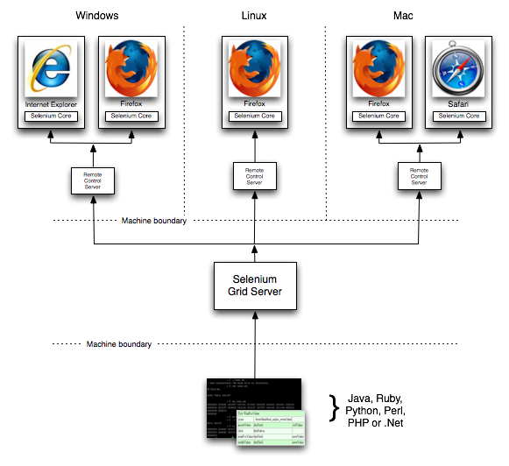
Selenium Grid infrastructure ingredients
Easy to install
Documentation
One installer script
Auto-scaling
solution created on top of Docker Swarm
Transparent infrastructure
on-premise or
cloud provider ( AWS, Azure, Google Cloud)
Well defined upgrade process
docker Selenium images

Slide 33


DevOps infrastructure ingredients
Jenkins as build and test executor
Cost efficient solution
Out of the box settings
Example Jenkins jobs
Jobs created with „Pipeline as a code” mind set
Build dependencies as continers
Docker registry for project docker images
Docker Swarm

Slide 34
E2E Test Framework modules WebAPI test module
WebAPI module
UI
API
BACKEND
Database module
WebAPI module
UI (Selenium) module
Selenium Grid
Mobile (Appium) app *
Mobile Grid *
Standalone APP *
Security module
DevOps module
Test core module

Slide 35

WebAPI test module ingredients
Test case structure with Given When Then approach
Page Object Model architecture
WebAPI for REST tests with RestAssure library and Java
Easy to enhance into SOAP

Slide 36







Security test module ingredients
Define the scope of security assurance
Derive user stories
Static code analysis
Dynamic code analysis
Custom unit tests
Code security *
Vulnerable library detection *
Proxy active scan *
TLS configuration scan *
BDD Security
Other
* - task able to enhance in DevOps module

Slide 37
Database test module ingredients
Used against SQL database with JPA interface and Java
Multiple database connection support
Object Relational Mapping
Easy to enhance into noSQL databases
CSVs and flat files structure and data validation
Main CRUD commands implemented with data type control

Slide 38

Mobile App test module * ingredients
One business test logic for all platforms
Page Object Model architecture
Native mobile app tests for Android and iOS with Appium library and Java
* - task not started, to be defined

Slide 39
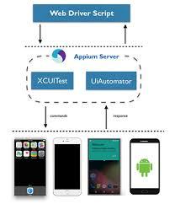
Mobile Grid infrastructure * ingredients
Easy install
Build in auto-scaling functionality
Solution created on top of Docker Swarm and Docker Selenium images
Transparent to on-premise or cloud provider
Android emulator as scalable docker image
Plug and play real devices (Android and iOS)
* - task not started, to be defined

Slide 40
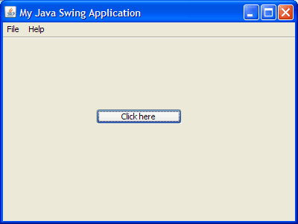
Standalone app test module* ingredients
Swing library with Java
Page Object Model architecture
* - task not started, to be defined

Slide 41
E2E Test Framework for DevOps & Smart Automation
UI
API
Unit
One to fit all
Infrastructure support
Practictional expertise
DevOps
E2E test in one file
Core functions (Java, Cucumber)
UI module (Selenium)
WebService module (REST, SOAP)
DataBase module (Oracle, Cassandra)

